Slide 1
Agenda :-
Problem Statement
Objective and methodology
Solutions
Business Impact

Slide 2
Problem statement:-
A man has took a shop in Rent near BTM Layout,Bangalore,not in the main road but as a local shop. The rent of the shop is 14000 per month. The man took the shop to sell fast food like -Biryani, Maggie, Egg Bhujia, Omlets, Chicken Kabab etc.
a.In the first 3 months he make a profit of around 100000, with a sales of around 300000.
b.In the 1stmonth he was selling veg food also, but he stopped after the 2ndmonth as it stock was not getting out.
c.After 4 –5 months down the line the man is making a huge loss in his investment. He has a due of 2 months to pay the rent.
d.The sale has drastically gone down and he is thinking to close the shop.
e.The Man is very lazy in working hard and also very poor in any other investment

Slide 3
Objective and methodlogy
Advetize a shop in Banglore
Recognize what exactly should be done on particular areas

Slide 4
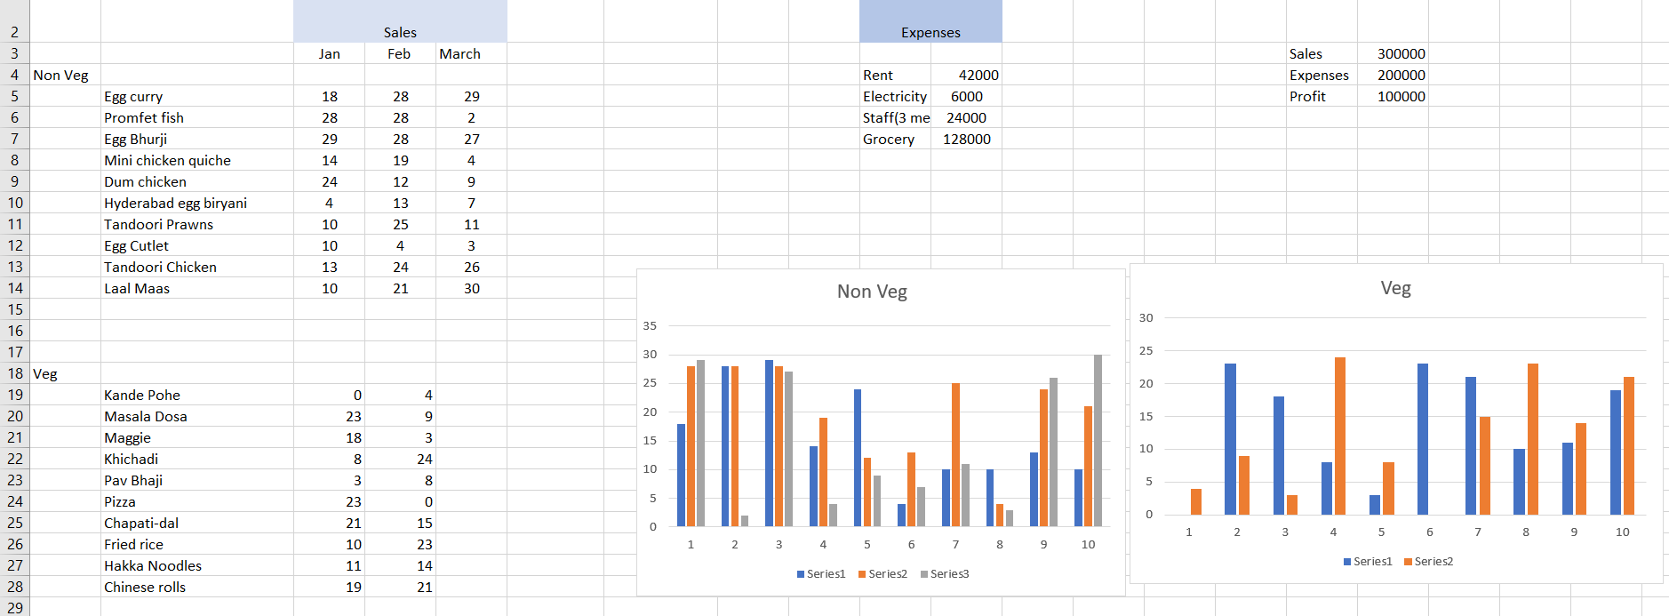
Total sales and expanses & their graphical representation:-

Slide 5
Solution : -
Online delivery
Investment
Place
Price
Food items ( especially veg food)

Slide 6
Business Impact:-
These solutions would help the man from getting out of the stock.
It will eventually help him to grow his business.

